Slide 1
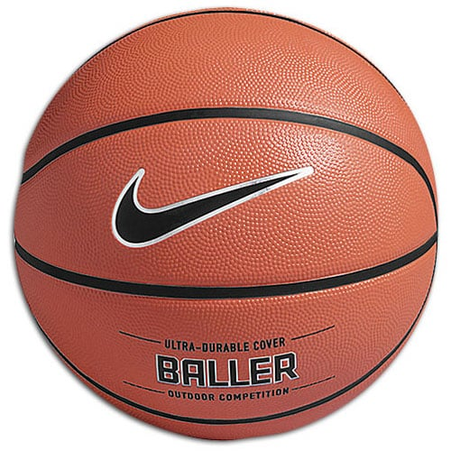
Viability of NBA Advanced Metrics in Predicting Wins
Brian Zamkotowicz
January 2019
Springboard Capstone Project

Slide 2
The Problem
Can NBA Advanced Metrics be used to predict wins in an upcoming season?
Is this information readily available?
What statistics might be good predictors?
Who can use this information?
How can this information be applied in the real world when building an NBA team?
Notes:
Basketball reference.com, How to pick stats, NBA front offices prioritizing offseason transactions. Hope to build a model that highlights what stats to focus on.

Slide 3
The Process
Obtain the data and begin to think about feature selection.
Clean and organize the data in useable way.
Examine the data and begin to pinpoint relationships within the data set.
Use the information to build a predictive model.
Use the model to make recommendations to the client base.

Slide 4
The Data
Availability of a great number of statistics on basketball-reference.com.
Create a method for dealing with rookies statistics.
Correct for team name changes in the given timeframe.
Deal with players who changed teams mid-season.
Normalize data for lockout-shortened 2012 season.
Notes:
Rookies were dealt with by copying their rookie season statistics back into the previous season. While this is in imperfect method, it made rookies appear to perform “as expected,” in their first season
Name changes : Nets moved to Brooklyn, Charlotte moved to New Orleans, New Orleans changed name, Charlotte got their old name back
After some data exploration, mid-season changes actually did not need to be adjust for as all the statistics had a playing time element to them.

Slide 5
The 2012 Lockout
Outliers in the Data
Normalizing to an 82 Game Season
Before Normalization
After Normalization
Notes:
The 2012 season was only 66 games. This created a situation where teams in 2012 had unusually low win totals. 2013 teams had unusually high win deltas because they had 16 extra opportunities to win games. These results were creating undue leverage and affecting the accuracy of the model.

Slide 6
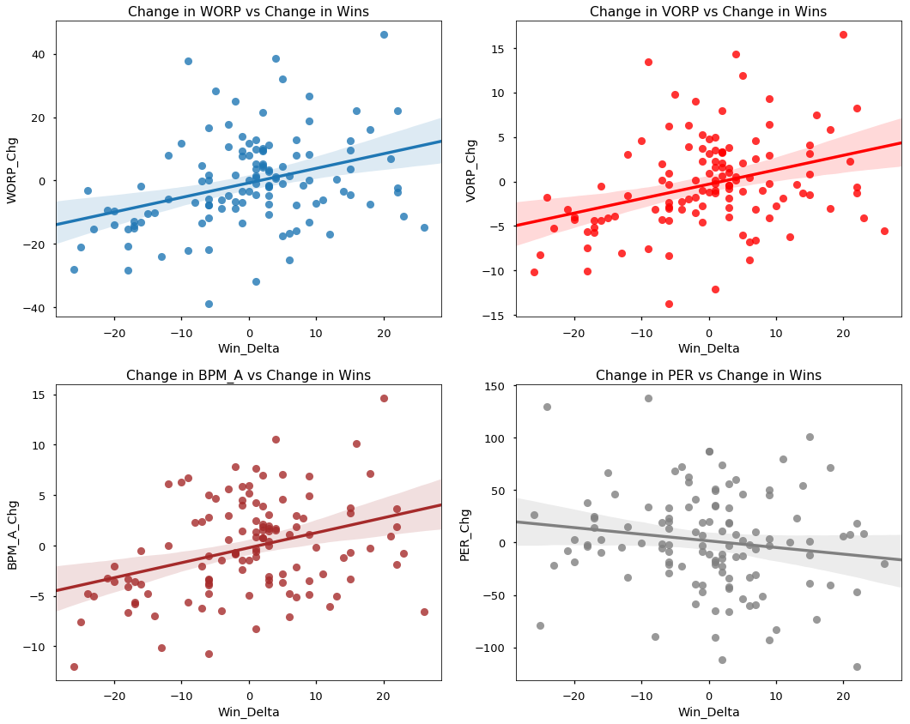
The Statistics
Notes:
Picked 4 statistics, WORP, VORP, Box Plus Minus (Adjusted for overall minutes), and PER. Explain each statistic. 3 of the 4 show clear positive correlation to change in wins.

Slide 7
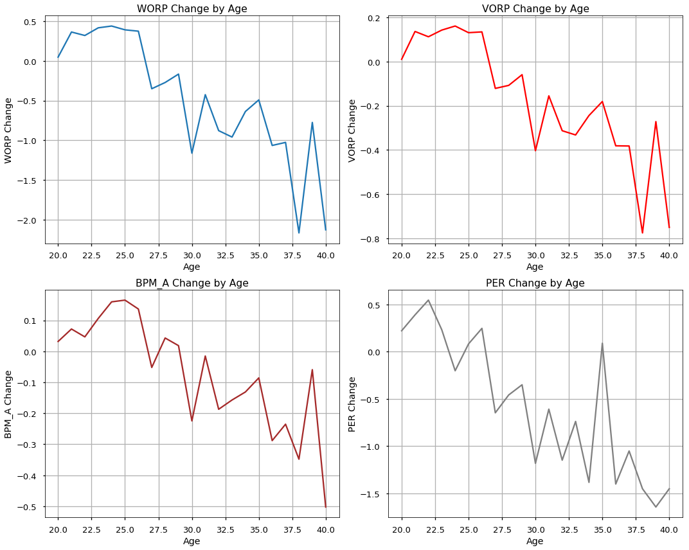
The Effects of Age on Player Statistics
Notes:
I expected a bell curve shaped effect on age where players reached a peak and then steadily declined. I thought that might be one way to predict players’ future performance. While player stats did seem to peak around age 25, the decline was far from linear. Also some anomalous spikes can be seen at advanced ages. A bit of further research explained that very few players were in the league at these ages and that one or two exceptional performances could really skew the results.

Slide 8
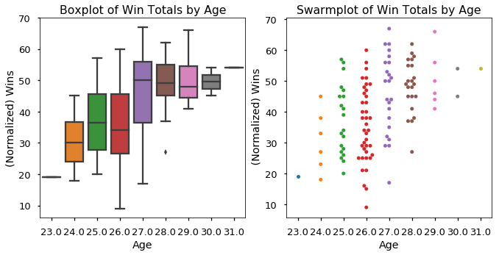
Does Age Relate to Wins?
Notes:
Another metric I though might be useful as a predictor was the average age of teams. Again I expected a bell curve, with young and inexperienced teams and teams with older, declining players on the two ends. Again the visualization showed little or no drop-off for older teams. The only thing really gained from this examination was thatteams with an average age of 26 or lower were unlikely to win more than half of their games.

Slide 9
Which Model Works Best?
Prediction | Model Type | MSE | Variance | Lower Bound | Upper Bound | 90% Range Width
Total Wins | Linear Regression | 93.47 | 0.47 | -11.2 | 18.5 | 29.7
 | Lasso Regression | 87.02 | 0.5 | -10.2 | 18 | 28.2
 | Ridge Regression | 92.99 | 0.47 | -11.1 | 18.5 | 29.6
 | Linear SVR | 97.21 | 0.44 | -6.9 | 21 | 27.9
 | Ridge Regression CV | 86.55 | 0.51 | -9.7 | 18.2 | 27.9
 | Lasso Regression CV | 90.51 | 0.48 | -10.4 | 18.3 | 28.7
 | Elastic Net | 88.98 | 0.49 | -10.4 | 18.2 | 28.6
 | Random Forest | 84.38 | 0.52 | -11.3 | 15.9 | 27.2
Win Delta | Linear Regression | 110.64 | 0.27 | -16.9 | 18 | 34.9
 | Lasso Regression | 108.54 | 0.28 | -16.8 | 18 | 34.8
 | Ridgre Regression | 103.54 | 0.31 | -16.5 | 17.5 | 34
 | Linear SVR | 106.5 | 0.29 | -16.2 | 17.7 | 33.9
 | Ridge Regression CV | 103.54 | 0.31 | -16.5 | 17.5 | 34
 | Lasso Regression CV | 105.3 | 0.3 | -16.7 | 18 | 34.7

Slide 10
Tuning the Model
Creating a Random Grid
Tune the hyperparameters
from pprint import pprint
from sklearn.model_selection import RandomizedSearchCV
# Number of trees in random forest
n_estimators = [int(x) for x in np.linspace(start = 200, stop = 2000, num = 10)]
# Number of features to consider at every split
max_features = ['auto', 'sqrt']
# Maximum number of levels in tree
max_depth = [int(x) for x in np.linspace(10, 110, num = 11)]
max_depth.append(None)
# Minimum number of samples required to split a node
min_samples_split = [2, 5, 10]
# Minimum number of samples required at each leaf node
min_samples_leaf = [1, 2, 4]
# Method of selecting samples for training each tree
bootstrap = [True, False]
# Create the random grid
random_grid = {'n_estimators': n_estimators,
'max_features': max_features,
'max_depth': max_depth,
'min_samples_split': min_samples_split,
'min_samples_leaf': min_samples_leaf,
'bootstrap': bootstrap}
pprint(random_grid)
# Use the random grid to search for best hyperparameters
# First create the base model to tune
rf = ensemble.RandomForestRegressor(random_state = 17)
# Random search of parameters, using 3 fold cross validation,
# search across 100 different combinations, and use all available cores
rf_random = RandomizedSearchCV(estimator = rf, param_distributions = random_grid, n_iter = 100, cv = 3, verbose=2, random_state=42, n_jobs = -1)
# Fit the random search model
rf_random.fit(wins_X_train, wins_y_train)
rf_random.best_params_
{'n_estimators': 1600,
'min_samples_split': 10,
'min_samples_leaf': 1,
'max_features': 'sqrt',
'max_depth': 20,
'bootstrap': True}
)

Slide 11
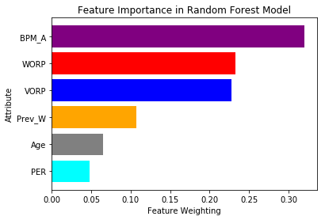
Feature Importance Analysis

Slide 12
Future Work
Player Injuries – Examining data on games lost to injuries could help remove outliers from the data.
Rookies – A more predictive system for rookies (perhaps based on draft position) could improve the model
Classification (Logistic regression) – A logistic regression version of the model would be useful for predicting a probability of improving based on statistical inputs.
Notes:
Classification might also have useful ramifications for betting.

Slide 13
Recomendations for the Clients
A working model that predicts NBA wins in a coming season was built.
WORP, VORP, and especially Box Plus Minus were shown to be effective predictors wins (even more than previous season wins)
An NBA General manager could use this model by plugging in stats of available players and making decisions based on the predicted wins associated with those transactions.

